Slide 1
Presented by: Sudharsanan S R Nan-Mudhalvan Id:au421221104043 College Name: Karpaga Vinayaga College of Engineering and Technology Title : Vehicle Image Generation using Generative Adversarial Networks (GANs)
3/21/2024 Annual Review

Slide 2
PROJECT TITLE
Vehicle Image Generation using Generative Adversarial Networks (GANs)
3/21/2024 Annual Review

Slide 3


AGENDA
Introduction
Problem Statement
Project Overview
End Users
Solution and Value Proposition
The WOW in Your Solution
Modeling
Results
Conclusion
3/21/2024 Annual Review

Slide 4

PROBLEM STATEMENT
Develop a GAN capable of generating new vehicle designs efficiently. Our
goal is to create a computer program that can automatically generate realistic pictures of vehicles, like cars and trucks. This is important for various purposes such as designing new vehicles or creating virtual environments for driving simulations. Instead of manually drawing or taking photos of every vehicle, we want to use advanced techniques called Generative Adversarial Networks (GANs) to teach the computer how to make these images on its own. By doing this, we can save time and resources while still getting high-quality images that look like real vehicles
Challenges:
Limited dataset size.
Inconsistent image backgrounds and angles.
Imperfect image quality due to small dataset.
3/21/2024 Annual Review

Slide 5

PROJECT OVERVIEW
Overview:
Goal: Develop a GAN to generate vehicle images.
Components: Generator model, discriminator model, training loop.
Dataset: Comprehensive Cars Dataset.
Methodology:
Data preprocessing.
Model training and evaluation.
3/21/2024 Annual Review

Slide 6

WHO ARE THE END USERS?
End Users:
Automotive designers and engineers.
Potential Use Cases:
Inspire new vehicle designs.
Efficient exploration of design possibilities.
Accelerate prototyping and innovation.
3/21/2024 Annual Review

Slide 7

YOUR SOLUTION AND ITS VALUE PROPOSITION
Solution:
Developed a GAN to generate vehicle images.
Value Proposition:
Efficient exploration of new vehicle designs.
Reduced prototyping costs and time.
Inspiration for designers and engineers.
3/21/2024 Annual Review

Slide 8
THE WOW IN YOUR SOLUTION
Ability to generate realistic vehicle designs.
Steady improvement in image quality during training.
Recognition of vehicle outlines and features.
3/21/2024 Annual Review
8

Slide 9
Modeling of Vehicle Image Generation using Generative Adversarial Networks (GANs)
GAN Architecture:
Generator model.
Discriminator model.
Training loop.
Dataset:
Comprehensive Cars Dataset.
1324 front-facing vehicle images.
3/21/2024 Annual Review
9

Slide 10
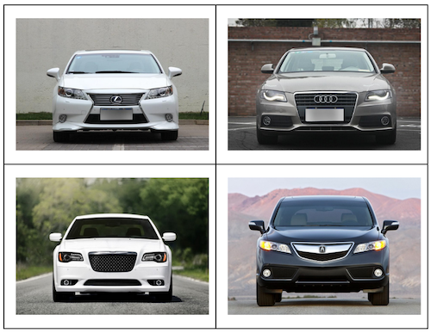
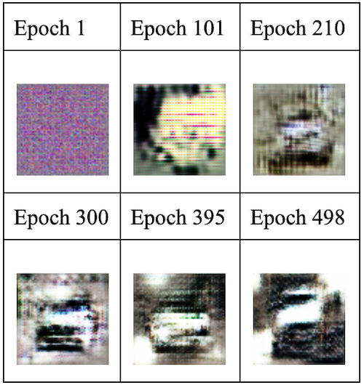
RESULTS
64px image generated
Sample data set
3/21/2024 Annual Review
10

Slide 11
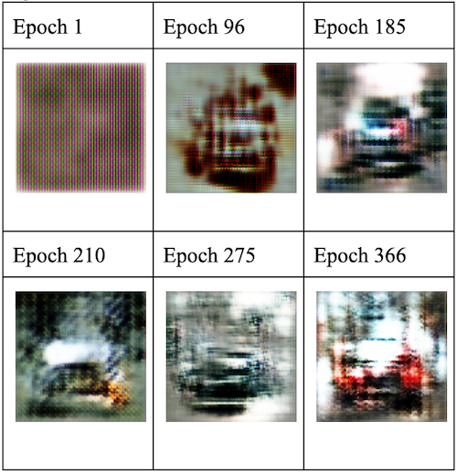
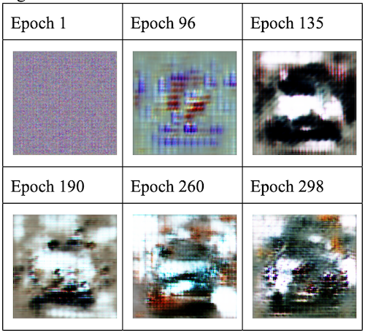
96px generated image
128px generated image
Challenges: Imperfect image quality due to dataset limitations.
Stagnation in model progress after certain epochs.

Slide 12
CONCLUSION
Conclusion:
Developed GAN for vehicle design.
Output recognizable vehicle images.
Limitations: Small dataset, inconsistent image backgrounds.
Future Directions:
Test on larger and more uniform dataset.
Explore higher resolutions and additional features.

